Slide 1

Investigating whether a Raspberry Pi executing facial recognition software can be used to securely identify a persons face and be integrated into a home to open a door lock without the need for a physical key.
Author Matthew Micallef
Institute of Information & Communication Technology
MCAST, Paola, Malta

Slide 2
Problem Definition
Facial recognition is not a new field of study nor is it new in the context that the implantation discussed will use it in.
The problem that needs to be solved is having the implantation be as cheap as possible so it can be attainable by everyone, the implementation needs to be as accurate as possible meaning that it needs to have a very high confidence rate and the implantation needs to be simple so that anyone interested in this concept can easily implement it.

Slide 3
Literature
The Topic for this research paper will be Computer Vision.
The Domain will focus on facial recognition.
Research papers were read to better identify what is needed for this implantation to work.

Slide 4
Aim, Hypothesis and Research Questions
The aim Of this research paper is to identify whether or not using facial recognition can replace a conventional key to open a lock on a door, using low cost hardware a Raspberry Pi 4 and a Raspberry pi camera.
The hypothesis for this research is the integration of a Haar cascade classifier, an LBPH algorithm, and a Raspberry Pi four and Pi camera to potentially create a superior form of entry to unlocking a lock without using a key in the aim of make it being more secure, affordable and user convenient.

Slide 5
Aim, Hypothesis and Research Questions
The following research questions where identified.
What kind of data set is required for detecting faces?
What algorithm can be used to best distinguish between faces? \
Is there any difference in the confidence levels when increasing the number of images taken for each new individual?
Is it safe to adopt this technology for the above mentioned use case?

Slide 6
Literature
The main sources for data with regards to information were research and academic papers. Which lead to the research questions identified above to be answord.
A data set for my implantation was not needed since I was taking and adding images whenever a new user was to be added. So in essence I was creating the data set.
With regards to algorithms, two are used mainly the Haar Cascade classifier and Local Binary Pattern Histogram (LBPH).
The Haar Cascade classifier is used for object detection recognising to identify whether their is a face in the frame or not
The LBPH algorithm is used to recognise the face based on the model trained.

Slide 7
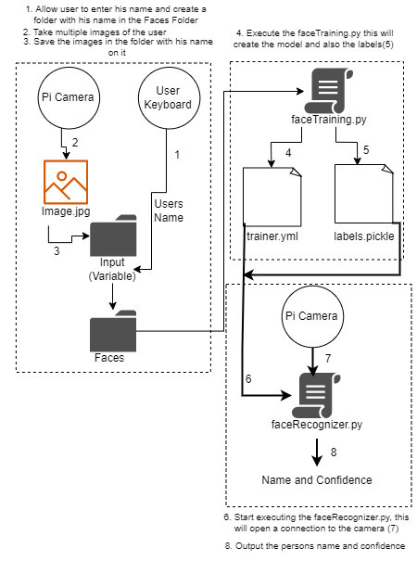
Methodology – Pipeline
The following phases were taken to implement the research paper.
Phase 1: A method where the user enters his name, and 20 images are taken automatically using the PI camera.
Phase 2: The model was then trained with the previously taken photos of him.
Phase 3: Start using the model to recognize who is in front of the camera

Slide 8
Evaluation / Argumentation
The Haar cascade Classifier produced very good results, this is evident from the images that were saved to the folder when a user is added. No images where saved that did not contain a face.
With regards to identifying the face, the LBPH algorithm was used, this produced mixed results as can be seen by the table below.
As can be seen from the table,
the results are mixed. Confidence
levels can be seen to fluctuate which
In certain test cases, 6 and 8 does
not make sense.
Test case | Subject | Number of images per subject | Average of the confidence level for 10 frames
1 | 1 | 1 | 68.28
2 | 1 | 10 | 81.973
3 | 1 | 20 | 87.40
4 | 1 | 40 | 88.89
5 | 5 | 1 | 84.13
6 | 5 | 10 | 67.24
7 | 5 | 20 | 75.70
8 | 5 | 40 | 68.32

Slide 9
Conclusions - Achievements
The implementation was carried out successfully at a high level, I believe that there could be some potential to this implementation after all the vulnerabilities have been fixed and the confidence level is significantly higher with minimal fluctuations.
The Haar Cascade classifier worked flawlessly which given the low amount of computational power that the raspberry pi has to offer was not expected.
The capturing of images of the user each time a person is added also worked perfectly and retraining the model each time does not take a lot of time.

Slide 10
Conclusions - Recommendations
It is recommended that a better camera would be used, since the video stream form the raspberry pi camera is not the clearest, when the ambient light is changing example reflections on the face cause problems.
Another classifier could be used to better identify the face, example the user must have his eyes open before the image could be processed.
From results obtained having a higher number of images that the model is trained on is not always better, during this study 20 images was identified as being enough but not too much images.

Slide 11
Thank you Matthew Micallef

